Slide 1


TEAM NEXORA · DOSM DATATHON 2026
HOW DOES
GEOPOLITICAL RISK
AFFECT TOURIST
ARRIVALS TO
MALAYSIA?
Official data and machine learning
on Malaysia’s top 20 source markets
Chin William · Tang Xin Yi ·
Janis Ong Jing Yao · Tee Xin Yee
UTAR · Advisor: Dr. Kelwin Tan Seen Tiong
Notes:
[Script §1 | 0:00–0:25 | 25 s | Speaker A | PJT1, INV2, INV3]
Good morning, judges. We are Team Nexora, four students from UTAR, with our advisor Dr. Kelwin Tan.
Our question is simple: how does geopolitical risk, like wars, conflicts and political tension, affect the number of tourists coming to Malaysia? To answer it, we used official data and machine learning on Malaysia's top 20 source markets.
[Next slide]
Sources: report cover (team, advisor, UTAR); report title.

Slide 2

THE CONTEXT
Tourism matters
to Malaysia
15.9%
3.7M
of GDP
tourism jobs
hotels
airlines
homestays
+0.08
THE PROBLEM
Nationally, risk seems
not to matter.
risk vs arrivals, all markets combined
THE GAP
Lee et al. (2021): no national link
Nobody had checked each country separately
02
Notes:
[Script §2, part 1 | 0:25–1:05 | 40 s | Speaker A | IMP2, PJT2, ANL1, INV1]
Tourism is very important to Malaysia. It makes up 15.9 percent of our GDP and supports 3.7 million jobs. So when risk goes up somewhere in the world, it can reach our hotels, airlines and homestays.
[Click] But here is the problem. If you look at Malaysia as one national number, the link between risk and tourist arrivals is only plus 0.08. That is almost zero.
[Click] Past research, by Lee and others in 2021, also found no link at the national level. And nobody had checked each country separately.
[Next slide]
Sources: report §1.1 (DOSM Tourism Satellite Account 2025: 15.9% of GDP, 3.7 million employed); report §4.2 (raw correlation +0.08); report §2 (Lee et al., 2021).

Slide 3

OUR OBJECTIVE
Test every market,
then forecast ahead
Test each of our
top 20 markets
Forecast arrivals
1–4 months ahead
When risk goes up, do tourists come…
A
less
B
more
C
both
03
Notes:
[Script §2, part 2 | 1:05–1:25 | 20 s | Speaker A | PJT2, ANL1]
So our objective was to test how geopolitical risk links to arrivals from each of our top 20 markets, and to forecast arrivals one to four months ahead.
Just think about this for a moment: when risk goes up, do tourists come less, come more, or both? My teammate will now explain how we found out.
[Optional: click A, B and C on the slide as you say "less", "more", "both"; each badge pulses.]
[Next slide — hand over to Speaker B]

Slide 4

HOW WE DID IT
Four steps, one rule
Collect
Date
Model
Test
69,040 daily rows →
2,300 country-months
Publish day,
not event day
Ridge for the link,
LightGBM machine
learning to forecast
5 rolling tests +
COVID stress test
→ Power BI
Only learns from numbers already published
04
Notes:
[Script §3 | 1:25–2:15 | 50 s | Speaker B | PJT4, ANL2, ANL4, INV5]
Thank you. We did this in four steps.
[Click] Step one, we collected official open data: about 69 thousand daily rows, which we turned into 2,300 country-months.
[Click] Step two, we dated every number by the day it is actually published, not the day it happened.
[Click] Step three, we used Ridge regression to measure the link with each market, and a LightGBM model to forecast one to four months ahead.
[Click] Step four, we tested it fairly, with five rolling tests on past years and a COVID stress test, and put the results in a Power BI dashboard.
[Click] Our main rule: the model only learns from numbers that were already published, so it never sees the future.
[Next slide]
Likely question: "How do you stop the model from seeing the future?" Answer: Every input is delayed by its real publishing time. The model only learns from arrivals that were already published on the forecast date. Source: report §3 (publication-lag alignment, row-level eligibility rule).

Slide 5

FIRST FINDING
The answer is both
C · Both
16
3
1
fewer tourists
more tourists
almost no change
e.g. Nepal, South Korea, Germany
Singapore, Indonesia, China
Thailand
20 modelled markets · associations, not causes
05
Notes:
[Script §4, part 1 | 2:15–2:50 | 35 s | Speaker B | ANL3, ANL5, PJT4]
Now our first finding. Back to the question: does risk push tourists away, or bring more in? Our answer is: both.
When we look at each country one by one, we see three groups.
[Click] For 16 of our 20 markets, like Nepal, South Korea and Germany, when risk goes up, fewer tourists come.
[Click] For 3 markets, Singapore, Indonesia and China, when risk goes up, more tourists come.
[Click] And for Thailand, there is almost no change.
[Next slide]
Likely question: "Why do Singapore, Indonesia and China go up when risk goes up?" Answer: We don't claim risk causes it. Risk went up in the same years that tourism recovered after COVID, so we think it is mostly the recovery trend. Source: report §4.2 (Table 5 and caveats); backup B.

Slide 6

KEY INSIGHT
Drops and rises
cancel out
16
3
+0.08
markets
markets
national
Watch risk market by market
Patterns, not proof of cause
06
Notes:
[Script §4, part 2 | 2:50–3:10 | 20 s | Speaker B | ANL5, INV1, ANL3]
Here is our key insight. The drops and the rises cancel each other out. That is why the national link is only plus 0.08.
[Click] One national number hides what is really happening, so risk must be watched market by market.
We are careful here: these are patterns, not proof that risk causes the change.
[Next slide]
Likely question: "How important is geopolitical risk in the model?" Answer: It is the 6th most used input. Past arrivals and season matter more, which makes sense. Source: report §4.1 (feature importance); backup B.

Slide 7

SECOND FINDING
LightGBM had the
smallest error
Average error · arrivals per market per month · tested on past data, as if live
07
Notes:
[Script §5, part 1 | 3:10–3:30 | 20 s | Speaker B | ANL2, ANL3, ANL4]
Our second finding is about forecasting. We tested every model on past data, as if it were live.
Our LightGBM model had the smallest error, about 16 thousand arrivals per market per month. It beat Ridge, it beat repeating last month, and it beat repeating last year.
[Next slide]
Likely question: "Is LightGBM really better than Ridge?" Answer: It had the lowest overall error, 15,969, and the lowest RMSE. But Ridge won 7 of the 20 test cells, so our choice is reasonable, not a big win. Source: report §4.1 Table 1; backup A.

Slide 8

HOW FAR AHEAD
Most accurate
1–2 months ahead
LightGBM average error, by months ahead
Month 1
Month 2
Month 3
Month 4
11,817
9,571
21,504
20,983
under 12,000
about double
During COVID, repeating last month won
08
Notes:
[Script §5, part 2 | 3:30–3:50 | 20 s | Speaker B | ANL3, ANL5, PJT4]
Forecasts are most reliable one and two months ahead, with error under 12 thousand. At three and four months, the error about doubles.
[Click] And one honest result: during COVID, simply repeating last month beat our model, because no model can learn a shock it has never seen.
[Next slide]
Likely question: "What if the arrivals data is published later than you assumed?" Answer: We tested a 3-month and a 4-month delay. The best model stayed the same. Source: report §4.1 (lag-sensitivity paragraph); backup A.

Slide 9

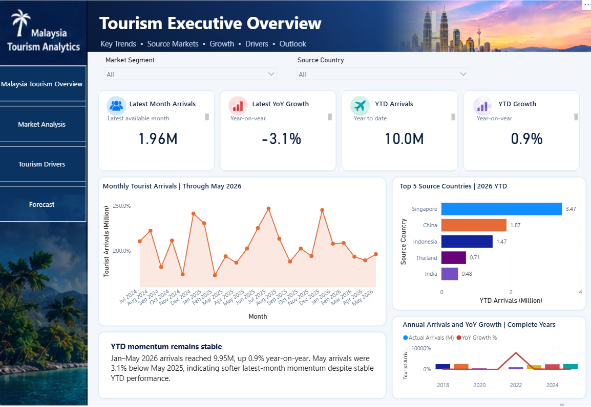
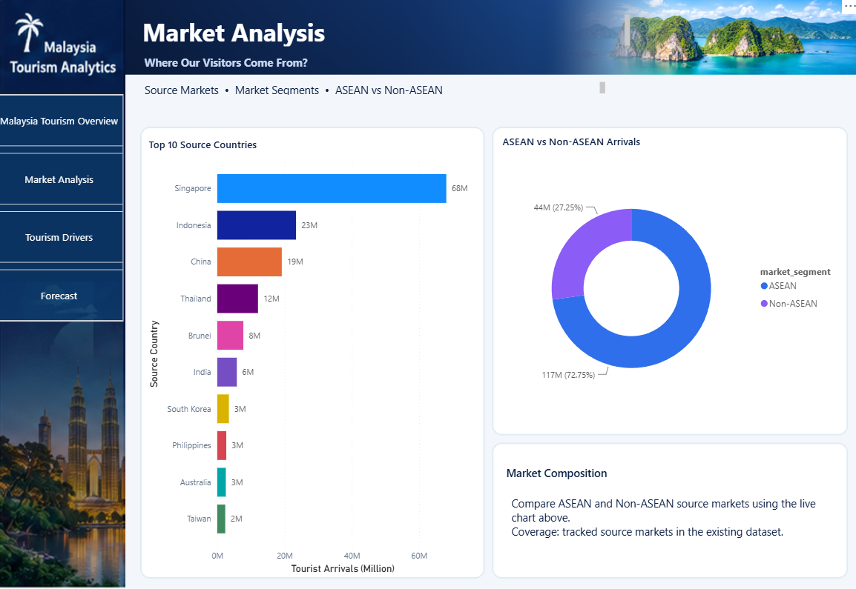
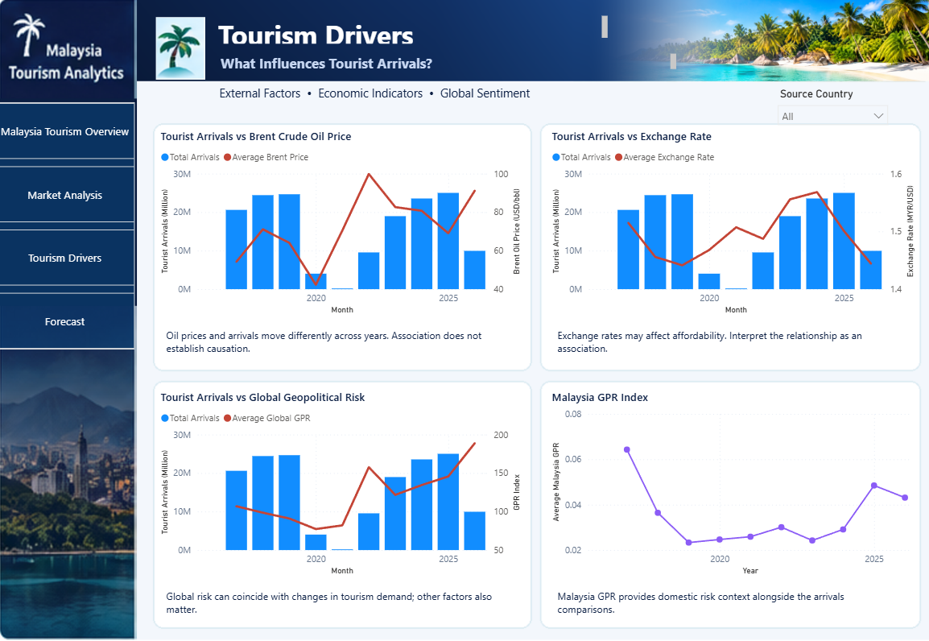
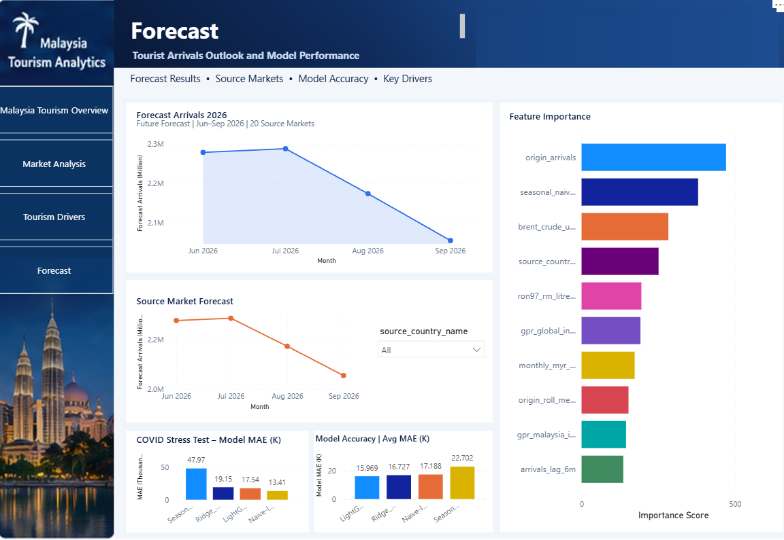
POWER BI DASHBOARD
Live demo:
four questions
Start: Overview
20 modelled markets
LIVE
1
Which markets matter?
Market Analysis
2
What moves arrivals?
Tourism Drivers
3
What do we forecast?
Forecast
4
How accurate is it?
Forecast
Demo backup ▸
09
Notes:
[Script §6 | 3:50–6:40 | 2 min 50 s | Speaker B | DEM1, DEM2, DEM3, DEM4, DEM5, INV4]
Now let me show you our dashboard. It follows the four pages on the left.
[Alt+Tab to Power BI. It should already be open on Malaysia Tourism Overview, full screen, both slicers set to All.]
Overview (20 s). [Point at the four cards, then the Top 5 Source Countries chart.] This page gives the big picture: the latest month, the year so far, and our top five source countries. Everything here covers our 20 markets, not all of Malaysia.
1. Which markets matter? (35 s). [Click Market Analysis, then click the Non-ASEAN part of the donut.] ASEAN countries bring most of our tourists, led by Singapore, Indonesia and China. When I click Non-ASEAN, the page shows only those markets. But being big is not the same as being sensitive to risk. [Click blank space to clear.]
2. What moves arrivals? (35 s). [Click Tourism Drivers, set Source Country to Singapore, then back to All.] Here you can compare arrivals with oil prices, the exchange rate and geopolitical risk, for any market. Each chart carries a short note, because these are associations, not causes.
3. What do we forecast? (35 s). [Click Forecast and point at Forecast Arrivals 2026.] Our model forecasts about 2.28 million arrivals from our 20 markets in June 2026. It stays steady in July, then slowly drops through September. [Set source_country_name to Singapore, then back to All.] You can also see the forecast for a single market.
4. How accurate is it? (30 s). [Point at Model Accuracy | Avg MAE (K), then the COVID Stress Test chart.] LightGBM has the lowest average error of the four models. During COVID the simplest method won, and we show that openly.
[Alt+Tab back to the slides and hand over to Speaker A. If Power BI freezes, click Demo backup and talk through the screenshots instead.]
[Next slide — hand over to Speaker A]
Likely question: "Can it run without your laptop?" Answer: Yes. The Power BI file has its data built in, the data file is included, and the Python pipeline updates with one command. Code is on GitHub: github.com/william20808/nexora_dosm.

Slide 10

WHY IT MATTERS
Useful, on-theme
and realistic
1
2
3
Useful
On-theme
Realistic
Tourism Malaysia
SDG 8.9
Open official data
DOSM
Supports SDG
12.b monitoring
One-command
monthly update
Hotels, airlines,
homestays
National Tourism
Policy 2020–2030
More markets
and states
Possible uses: impact not yet measured
10
Notes:
[Script §7 | 6:40–7:30 | 50 s | Speaker A | IMP1, IMP2, IMP3, IMP4, IMP5]
So why does this matter?
[Click] First, who could use it. Tourism Malaysia could decide which markets to promote in, and when. DOSM could add a market-level view next to the national number. And hotels, airlines and homestays could plan their staff earlier.
[Click] Second, it fits this year's theme, machine learning for sustainable tourism. It links to SDG 8.9 on tourism jobs and local culture, SDG 12.b on tools to monitor tourism, and the National Tourism Policy 2020 to 2030.
[Click] Third, it is realistic. It uses only open, official data, it updates every month with one command, and it can grow to more markets and states.
To be clear, we show how it could support decisions. We have not measured that impact yet.
[Next slide]
Likely question: "How would you measure SDG impact?" Answer: Our report lists indicators, such as tourism jobs, wages and local SME participation for SDG 8.9, and energy, water, waste and traffic for SDG 12.b. Source: report §5; backup C.

Slide 11

CONCLUSION
Three things
we found
1
2
3
Each market reacts
differently
Market by market
shows what one
number hides
Best forecasts
1–2 months ahead
OUR HONEST LIMITS
Patterns,
not causes
Shocks like COVID
can’t be predicted
20 markets only;
forecast ranges next
11
Notes:
[Script §8 | 7:30–8:00 | 30 s | Speaker A | ANL5, PJT2, PJT3]
To conclude, we found three things. Geopolitical risk affects each market differently.
[Click] Looking market by market shows what the national number hides.
[Click] And our model forecasts best one to two months ahead.
[Click] We are also honest about our limits. These are patterns, not causes. Sudden shocks like COVID cannot be predicted. And we only cover 20 markets, so forecast ranges are our next step.
[Next slide]

Slide 12

THE ANSWER
FOR 16 OF OUR 20
MARKETS, HIGHER
RISK GOES WITH
FEWER TOURISTS,
BUT NOT FOR ALL
That’s why we look market by market.
Terima kasih.
Q&A
Accuracy
Markets
Data & design
Demo
nexora-datathon-website
.vercel.app
Notes:
[Script §9 | 8:00–8:20 | 20 s | Speaker A | PJT1, PJT3, INV3; Q&A: PJT5]
So, how does geopolitical risk affect tourism in Malaysia? For 16 of our 20 markets, higher risk means fewer tourists, but not for all of them. That is why looking market by market matters.
[Click] Terima kasih. We are happy to take your questions.
[Q&A: short answers in simple English. Backup slides: A for accuracy, B for markets, C for data, D for the demo screenshots — click the buttons on this slide.]

Slide 13

BACKUP A · ACCURACY
Best at 1–2 months, robust
to the lag, humbled by COVID
MAE BY HORIZON · ARRIVALS PER MARKET-MONTH
COVID STRESS · 2020–22
Horizon | Naive-last | Seasonal-naive | Ridge | LightGBM
 | repeat last month | repeat last year
Month 1 | 12,752 | 23,802 | 12,117 | 11,817
Month 2 | 9,671 | 20,404 | 9,757 | 9,571
Month 3 | 25,157 | 21,191 | 24,258 | 21,504
Month 4 | 21,171 | 25,413 | 20,775 | 20,983
Aggregate | 17,188 | 22,702 | 16,727 | 15,969
Horizon | Naive-last | LightGBM
Month 1 | 9,647 | 12,805
Month 2 | 12,366 | 16,279
Month 3 | 15,511 | 20,730
Month 4 | 16,134 | 20,334
Naive-last wins every horizon
LAG TEST · SAME MODEL CHOICE
Horizon | Lag 3 | Lag 4 (used)
Month 1 | 12,611 | 11,817
Month 2 | 10,762 | 9,571
Month 3 | 20,835 | 21,504
Month 4 | 20,509 | 20,983
5 primary folds, Mar 2023–Sep 2025 · best per row highlighted
Ridge won 7 of 20 test cells
◂ Q&A index
13
Notes:
[Backup A · Accuracy | Q&A]
Is LightGBM really better than Ridge? It had the lowest overall error, 15,969, and the lowest RMSE. But Ridge won 7 of the 20 test cells, so our choice is reasonable, not a big win.
What if the arrivals data is published later than you assumed? We tested a 3-month and a 4-month delay. The best model stayed the same.
Sources: report §4.1 Tables 1–2 and the lag-sensitivity paragraph; backtest_accuracy_by_horizon.csv; covid_stress_test_summary.csv; L3_vs_L4_sensitivity_summary.csv.

Slide 14

BACKUP B · MARKETS
16 of 20 markets slope down;
the forecast leans on past arrivals
Arrivals per +1 SD of GPR Global · Ridge, USA as reference
38,626 ▸
LIGHTGBM SPLIT COUNT · TOP 6
Recent arrivals
471
Same month last year
380
Brent crude
283
Country
251
RON97 fuel
195
GPR Global
192
READ WITH CARE
Raw correlation +0.08
GPR vs time +0.54
Associations, not causes
SHAP is in-sample
◂ Q&A index
14
Notes:
[Backup B · Markets | Q&A]
Why do Singapore, Indonesia and China go up when risk goes up? We don't claim risk causes it. Risk went up in the same years that tourism recovered after COVID, so we think it is mostly the recovery trend.
How important is geopolitical risk in the model? It is the 6th most used input. Past arrivals and season matter more, which makes sense.
Sources: report §4.2 Table 5; report §4.1 feature importance; gpr_country_ridge_interaction.csv; lightgbm_feature_importance.csv.

Slide 15

BACKUP C · DATA & DESIGN
Every input is dated by release;
every design choice has a reason
Source | Inputs | Available after
Tourism Malaysia & Immigration | arrivals by nationality | assumed 4 months (3 tested)
Caldara & Iacoviello | GPR Global, Malaysia | ≈1 month
World Bank | Brent crude | ≈1 month
Bank Negara Malaysia | MYR exchange rates (+ BDT cross-rate) | real time
Ministry of Finance | RON97, diesel | weekly
DOSM MEI | leading & coincident indices | ≈2 months → excluded
Why pooled?
~111 months per market is too few
Why direct multi-horizon?
No error carried month to month
Why MAE and RMSE, not MAPE?
Tiny markets blow up percentages
Why USA as reference?
Identifies every market’s slope
Why drop DOSM MEI?
3–4 months stale; near-zero weight
Why LightGBM over Ridge?
Lowest total error, pooled design
SDG OUTCOME INDICATORS
SDG 8.9: tourism jobs, wages, local SME participation
SDG 12.b: energy, water, waste, traffic
◂ Q&A index
69,040 daily rows → 2,300 country-months · same rule in backtest and deployment
15
Notes:
[Backup C · Data & design | Q&A]
How do you stop the model from seeing the future? Every input is delayed by its real publishing time. The model only learns from arrivals that were already published on the forecast date.
How would you measure SDG impact? Our report lists indicators, such as tourism jobs, wages and local SME participation for SDG 8.9, and energy, water, waste and traffic for SDG 12.b.
Can it run without your laptop? Yes. The Power BI file has its data built in, the data file is included, and the Python pipeline updates with one command. Code is on GitHub: github.com/william20808/nexora_dosm.
Sources: report §3 (data, provenance and publication lags); report §5 (SDG indicators).

Slide 16

BACKUP D · DEMO
Demo backup: the same four
questions, as screenshots
Start
1
Overview
Which markets matter?
20 modelled markets
Market Analysis
2
3 & 4
What moves arrivals?
What do we forecast?
How accurate is it?
Tourism Drivers
Forecast
◂ Q&A index
◂ Back to demo
16
Notes:
[Backup D · Demo screenshots | fallback if Power BI freezes]
Talk through the same four questions in the same order: start on the Overview, then 1. Which markets matter? (Market Analysis), 2. What moves arrivals? (Tourism Drivers), 3. What do we forecast? and 4. How accurate is it? (Forecast). Use the same sentences as the live demo, then click "Back to demo" or go to the next slide.

